Slide 1
RetroBug Output
P3_JoeyBloom_Assign43_RetroBug

Slide 2
Notes
Uses a Stack to store entire path, not just last action. Can call restore() multiple times to retrace entire path.

Slide 3
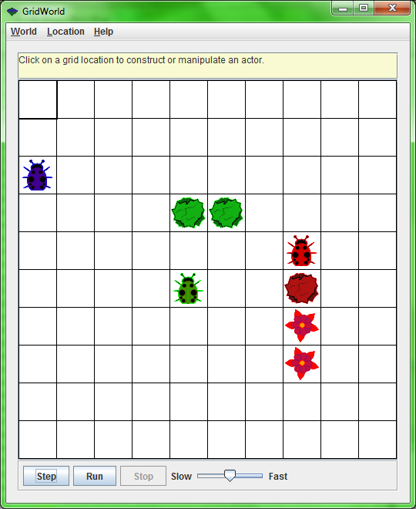
Initial Setup

Slide 4
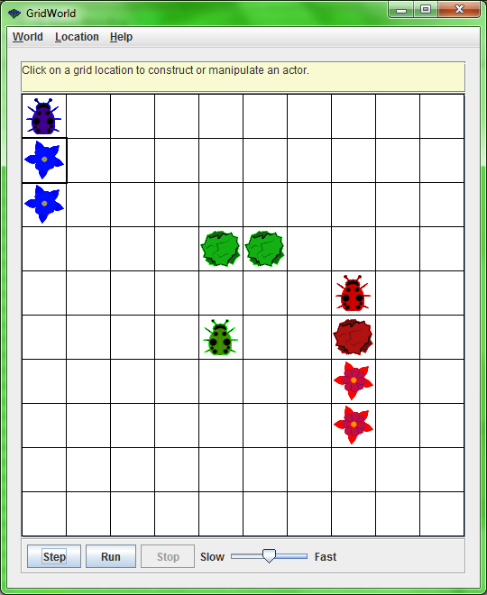
After 2 calls to act() on blue bug

Slide 5
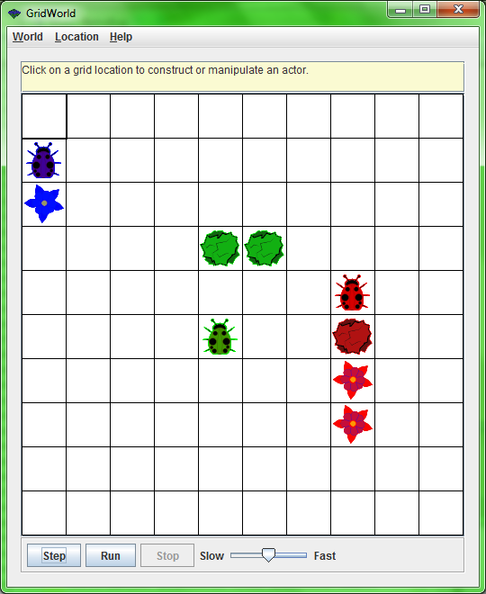
Restore on blue bug, moves backwards

Slide 6

2nd restore on blue bug, moves backwards

Slide 7
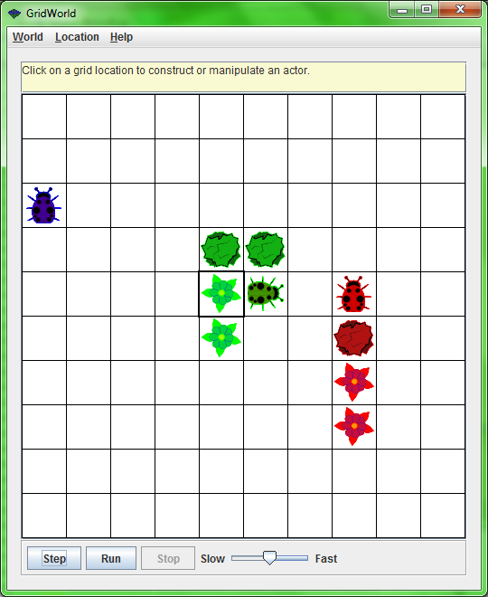
After 4 calls to act() on green bug

Slide 8
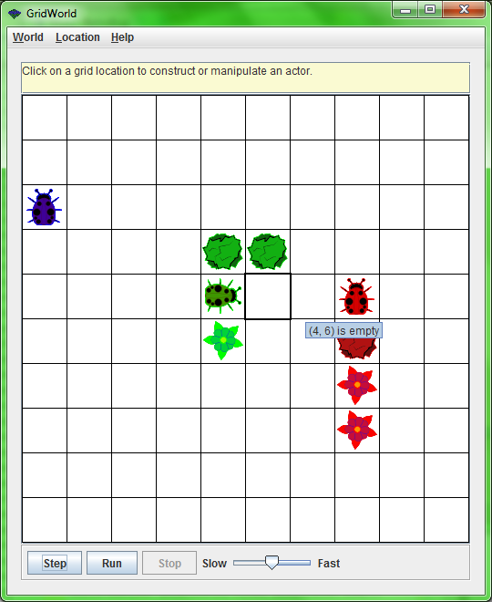
4 restores on green bug, retraces path

Slide 9
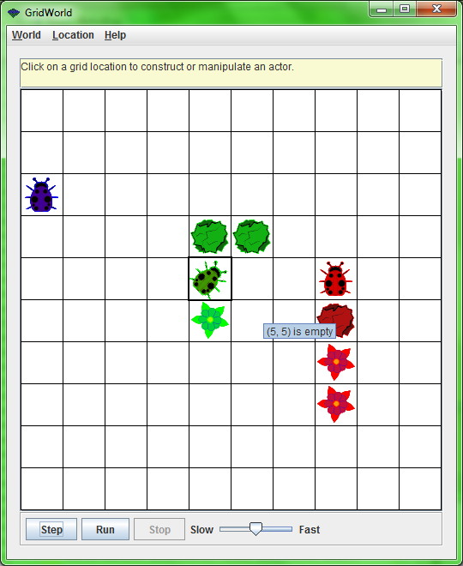

Slide 10


Slide 11
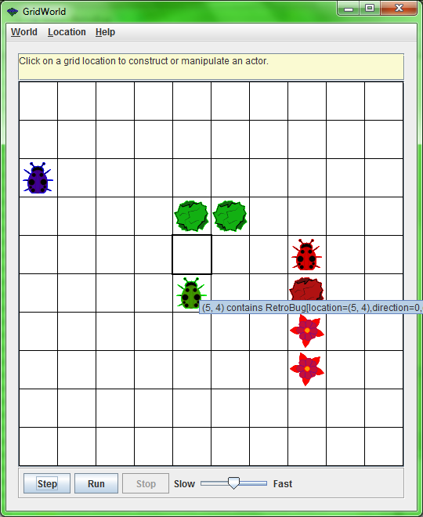

Slide 12

Red bug has rock behind it; cannot restore. After multiple restores, still in same place.

Slide 13
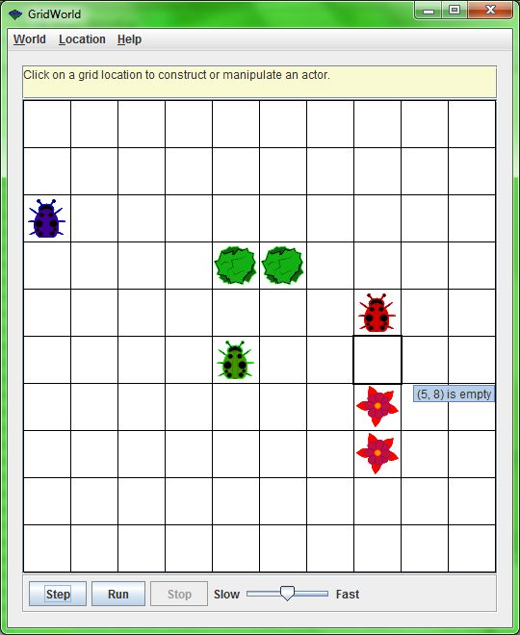
Remove red rock

Slide 14
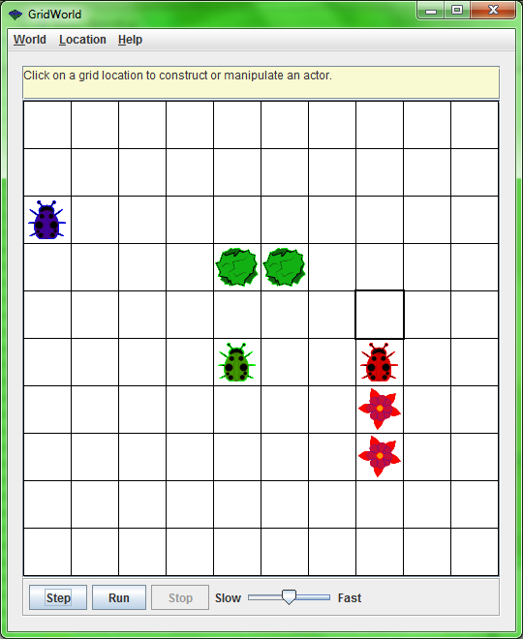
3 calls on restore(), red bug retraces path from before the red rock was there

Slide 15
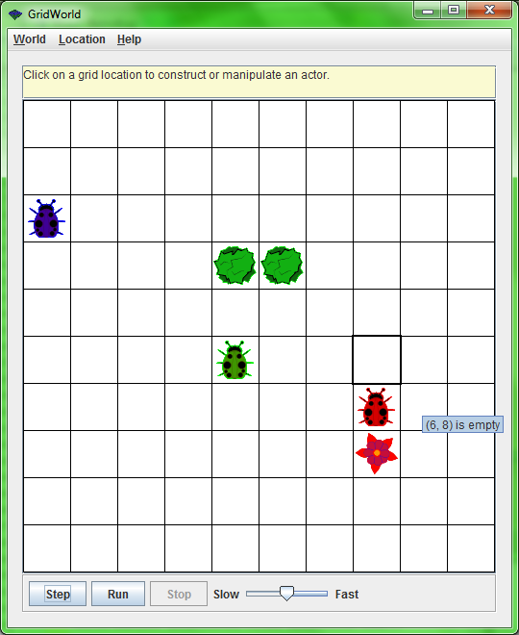

Slide 16
